Slide 1
IEEE Project Competition
Week 3: Onshape

Slide 2
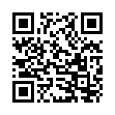
Signup Form

Slide 3
Reminders
Membership check is today!
Please make sure to have a computer and mouse on hand.
Group finalization we will get to that at the end of the workshop.
General structure for today:
Membership check -> Onshape workshop -> Group Finalization -> End of workshop -> If interested (Fusion 360 and Solidworks installation guide).

Slide 4
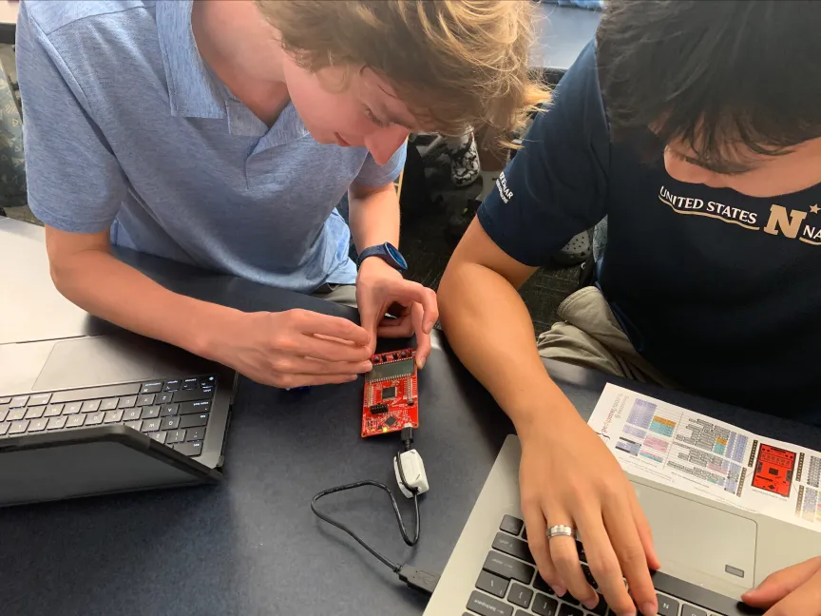
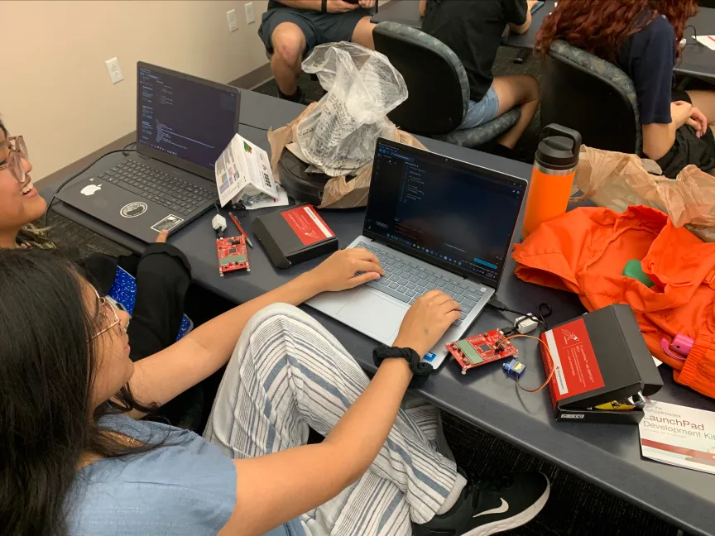
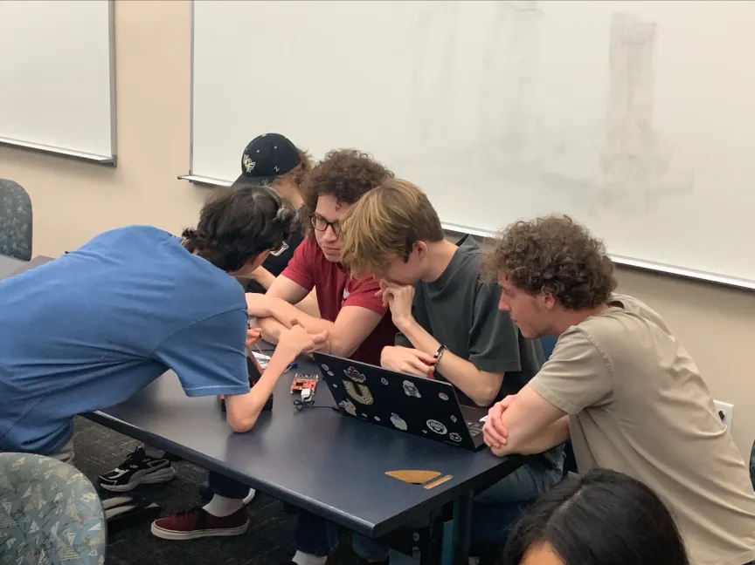
Recap From Last Week
Microcontrollers can do a lot.
Installation.
Went over basic C++ environment.
Reviewed functions in C++.
Learned how to setup inputs/outputs

Slide 5
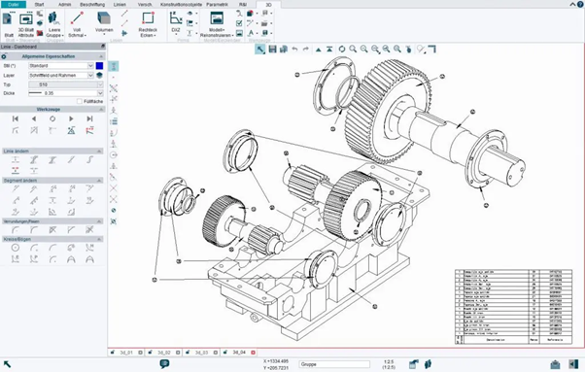
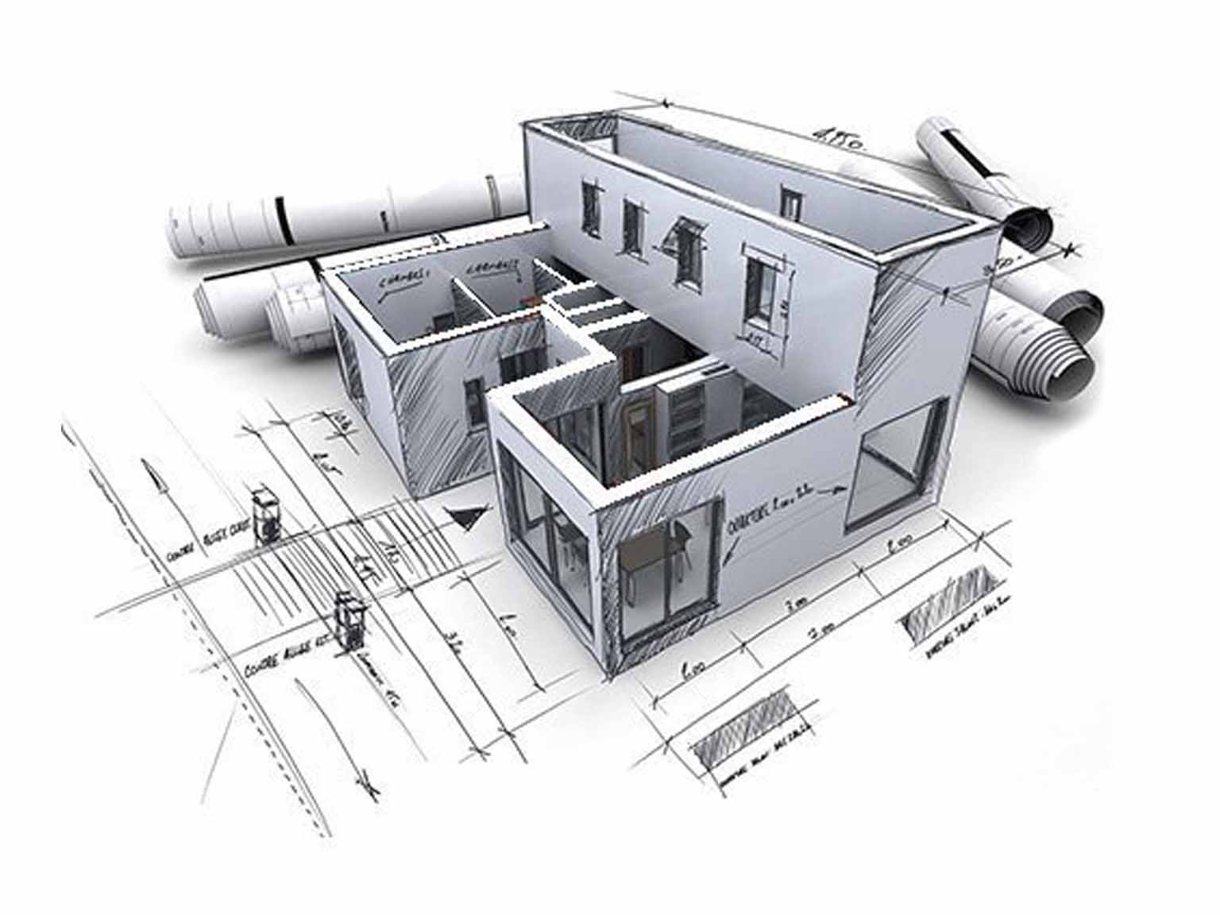
What is CAD?
Definition:
Computer-Aided Design (CAD) involves using computer systems to assist in creating, modifying, analyzing, or optimizing designs.
Applications:
Engineering
Architecture
Product Design
Automotive and Aerospace Industries
Benefits:
Increased productivity
Improved design quality
Enhanced communication through documentation
Creation of a database for manufacturing

Slide 6
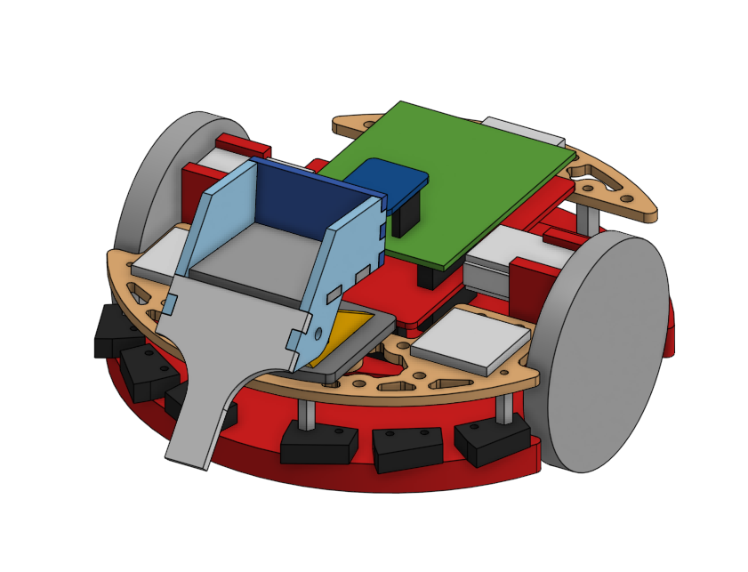
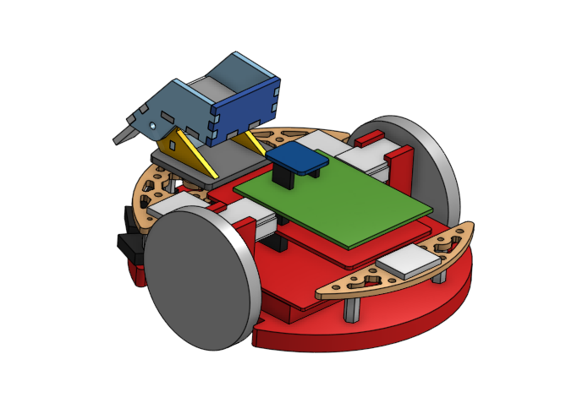
What your CAD might look like?

Slide 7

What is Onshape?
What is Onshape?
A fully cloud-based 3D CAD platform.
Allows for real-time collaboration and design sharing.
Key Features:
No downloads or installations required.
Accessible from any device with an internet connection.
Automatic version control and branching.
Who Uses Onshape?
Engineers
Designers
Educators and Students
Hobbyists

Slide 8
Onshape
Main Components:
Documents Page: Organize your projects.
Part Studio: Create and edit parts.
Assemblies: Combine parts to create complex models.
Interface Overview:
Toolbars: Access sketch and feature tools.
Feature Tree: View the history and structure of your model.
Graphics Area: Main workspace for modeling.
View Cube: Navigate different views of your model.

Slide 9
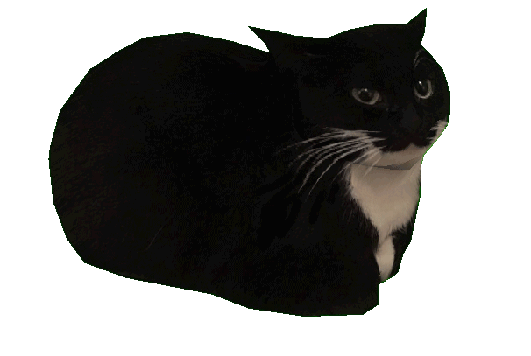
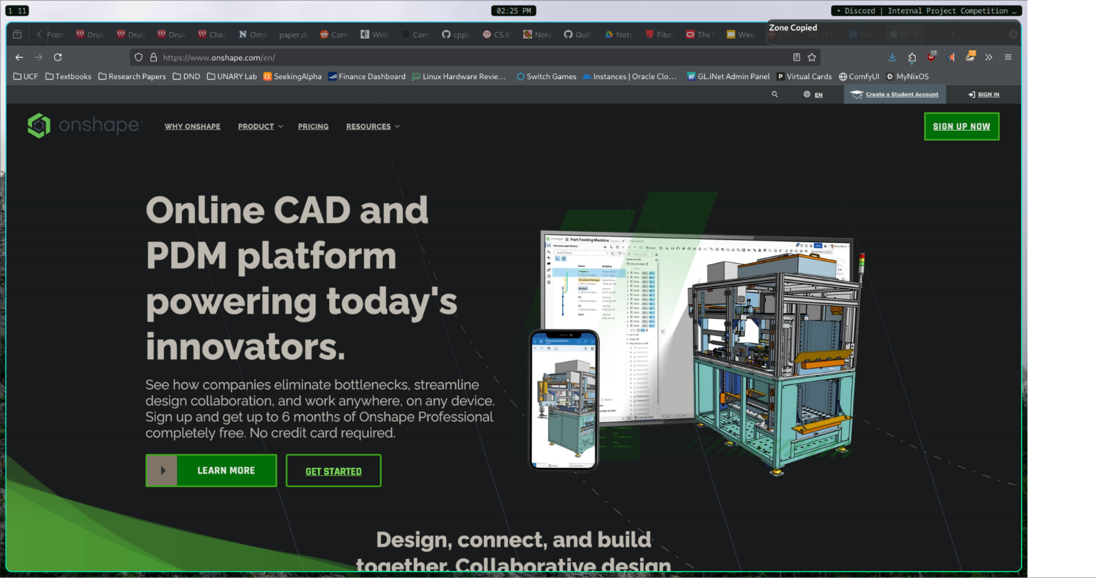
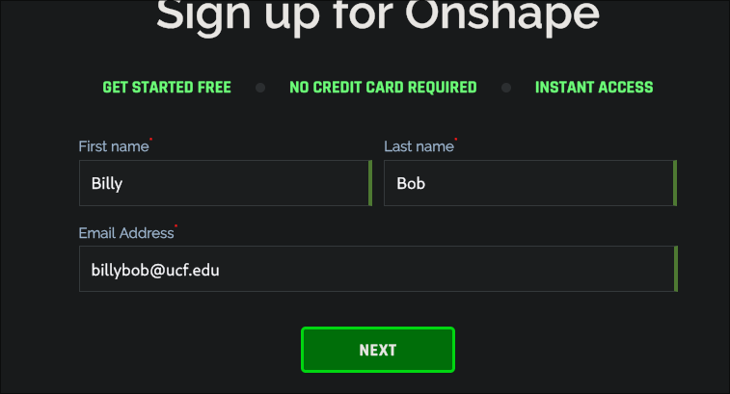
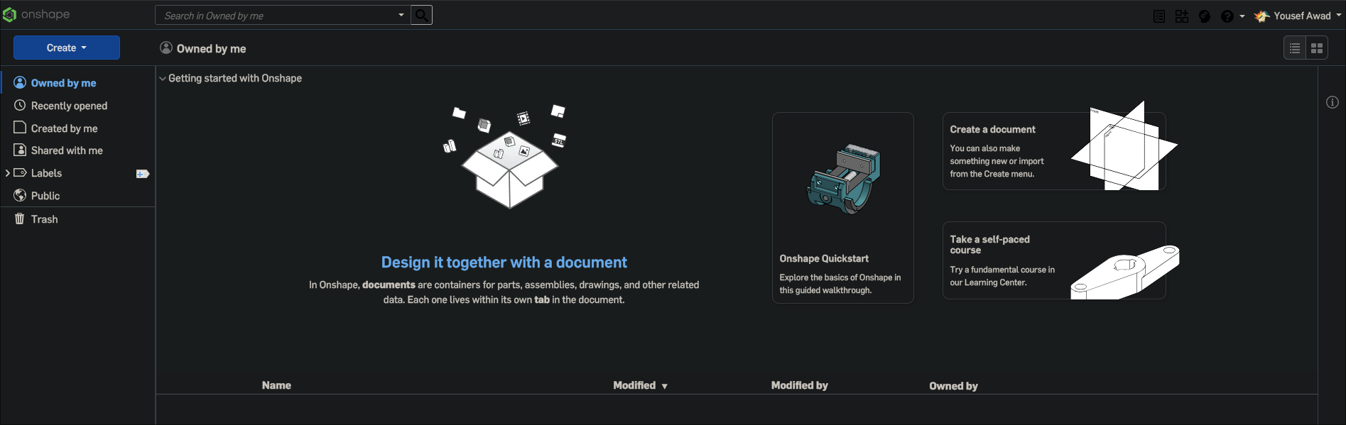
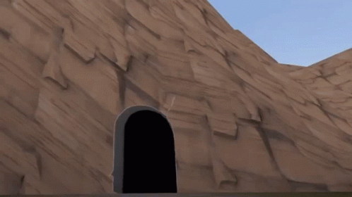
How do you get this “Onshape”?
Go to https://www.onshape.com/en/
Click “Sign Up Now” (see picture)
Sign Up with your UCF Email (required)
Fill out the details that follow until it stops (sad, I know).
Click “Create” to start a new CAD drawing!

Slide 10
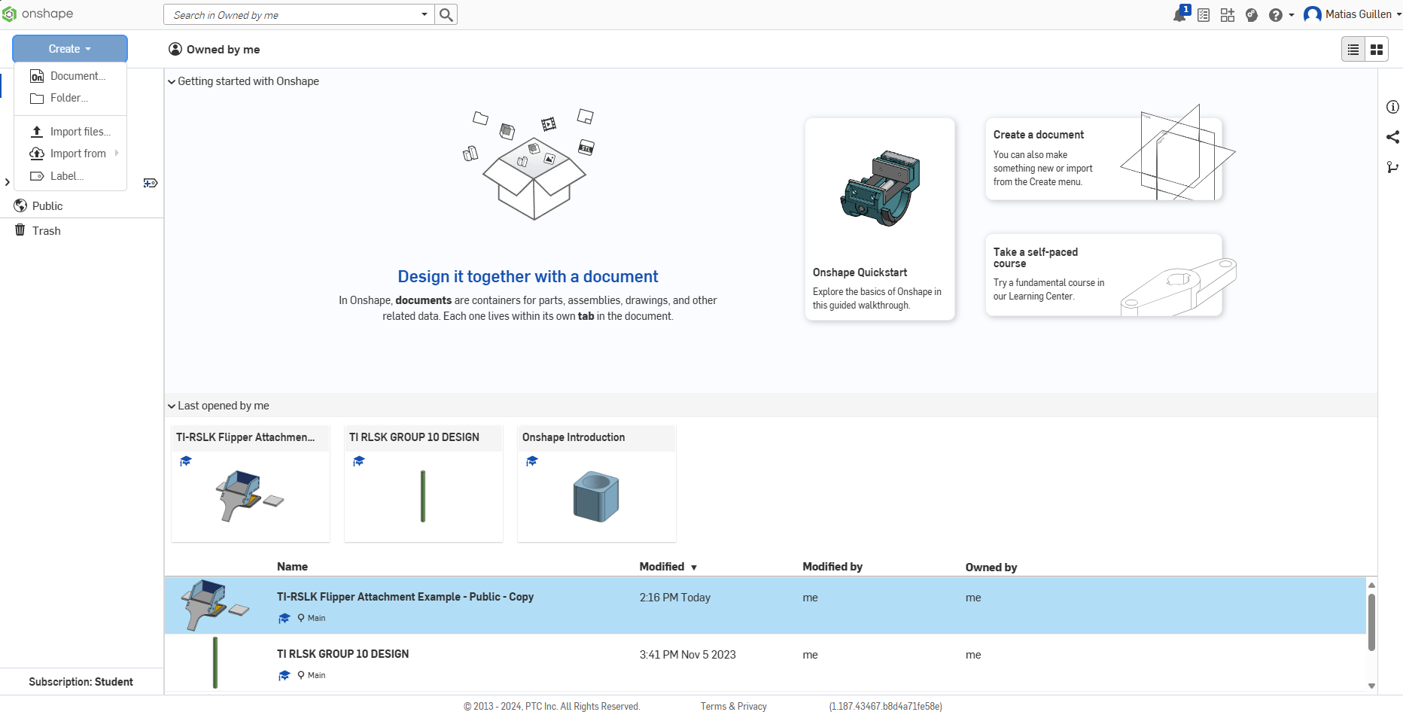
Creating your first model!

Slide 11
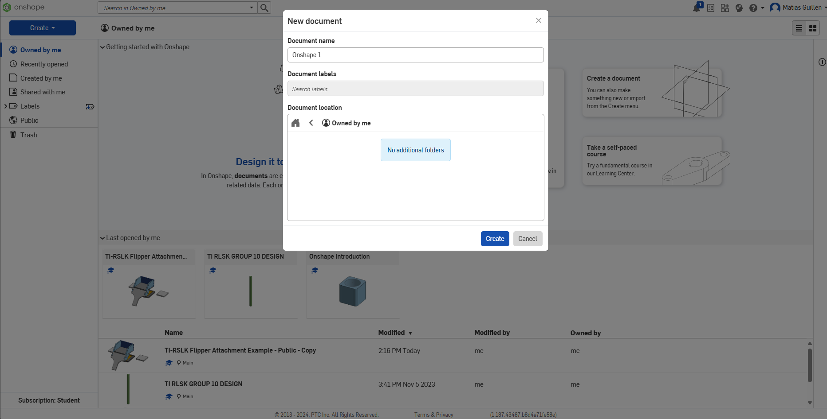
Creating your first model!

Slide 12
Example see screen: Example File

Slide 13
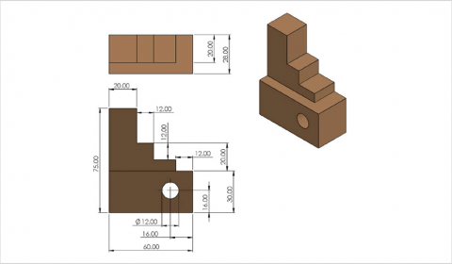
Final Example Part

Slide 14
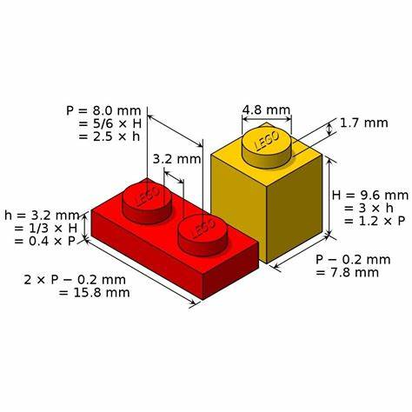
You do!

Slide 15
Team Finalization
If you really want to work alone you can. But you will need to fully fund your project you can still participate in workshops and technical help in addition to rewards.
We will be combining groups (sorry). 2 people per team minimum.
Still not too late to join!
Funds won’t be given till we have a BOM (Bill of Materials submitted by you where we will order the parts for you.)
Green means approved.

Slide 16
Team Rooster
Electric Skateboard (Mini) - Beginner | Block Moving Robot - Advanced | Audio Visualizer - Beginner | Sheet Music Microphone - Beginner | LED Related Project - Beginner | Arcade Game - Advanced | Unsure | Unsure
Evan Eichholz | Eric Segrest | Alexander | Mike | Bree | Aldem | Logan | Abdiel
Floating Magnet - Beginner (Paying) | Batmobile - Beginner | LED Pitch Changer - Beginner | Climbing Robot - Beginner | Mobile Game - Beginner
Joshua Guo | Amy Diaz, Liani Garcia, Jennifer | Landon Luke, Ryan Moran, Samual, Hustin | Viviana, Frankey, Rolando, Keya | Joshua, Jacob, Jason

Slide 17
Timeline and Important Dates
Weekly Meetings - Estimated Timeline (Starting September 16th)
Week 1 | Week 2 | Week 3 | Week 4 | Week 5 | Week 6
Introduction | Microcontrollers - Erik | Fusion 360/Solidworks - Matias | KiCAD -Tino | Soldering/Prototyping/BOM help - Yousef/Matias | BOM Development/Submission

Slide 18
Next Week’s Session:
KiCad workshop Tino!
Group brainstorming and research phase.
BOM Development.
Next session will be on Monday, October 7th.

Slide 19

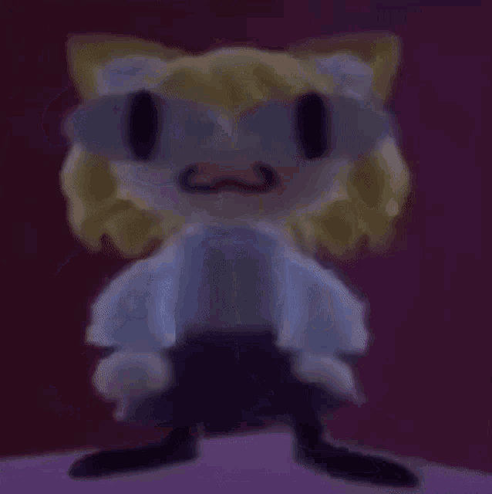
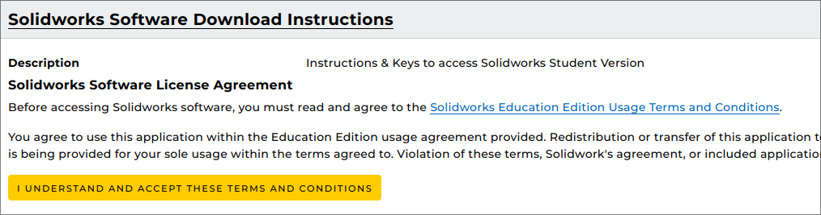
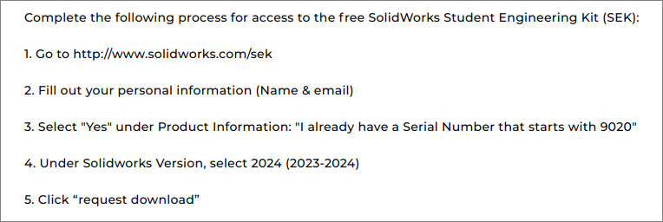
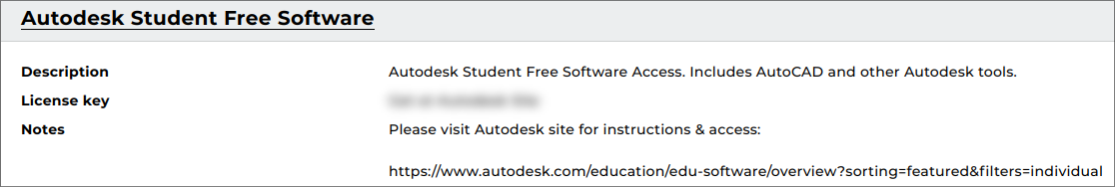
But how do you download the other tools????!!!
Simple!!
Go to https://my.cecs.ucf.edu/ and login with you NID and password
Click “I Understand”
Follow the instructions listed when u scroll down

